Slide 1
WCF RIA Services
Introduction
Demo
Questions

Slide 2
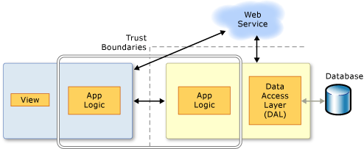
WCF RIA Services
This illustration shows a simplified version of an n-tier application. RIA Services focuses on the box between the presentation tier and the data access layer (DAL) to facilitate n-tier development with a RIA Services client

Slide 3
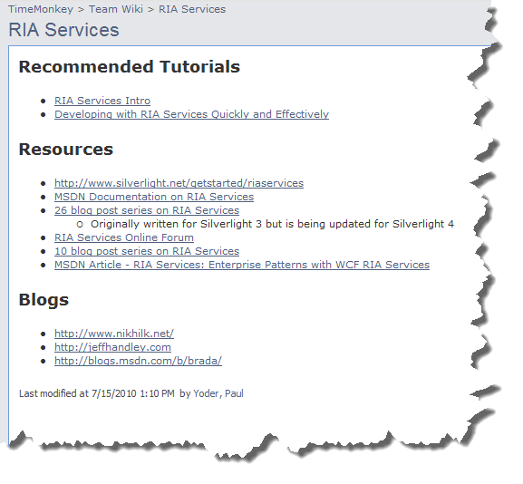
WCF RIA Services
Find Resources on the Time Monkey Project Wiki

